Slide 1
Audio-Visual Presentation
Student Name
Institution Name
Course Number
Due Date
Faculty Name

Slide 2
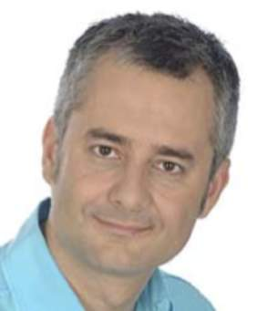
Background of the speaker
The speech was presented by Albert-Laszlo Babarasi.
Albert is a renowned physicist famous for his research on scale free networks as well as network theory.
He is as well a major actor in the development of network science and the independent research on the concept of scale free network.

Slide 3
Summary of the Speech
He identifies the hidden techniques which are used to enhance success.
In order to identify the individual success, we need to differentiate success from performance.
Performance refers to personal input while success required group interaction.
Success is random and can come at any age but the changes take place in productivity and creativity level.

Slide 4
Organization of the Speech
The speech was well organized
In the introduction the speaker began with explaining the connection between age and success and how they relate.
Then the speaker began the body of the speech supporting each with examples
The speaker concluded the speech by providing a summary of his speech. He as well acknowledged his audience.

Slide 5
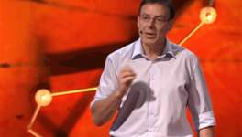
Presentation Skills and Presentation Aids
Albert-Laszlo has good and effective presentation skills
The speaker had planned for the speech well.
The outline was well supported by his argument using examples, pictures and videos.
The speaker delivered the speech well through the use of non verbal cues such as gesture, tone variation, eye contact and facial expressions.

Slide 6
Conclusions
The speaker was effective in bring out the association between age and success
This was due to his effective presentation skills and presentation aids used.
The speech was as well organized in a way that was easy to understand and follow.

